Slide 1
Computer Lab II
Jessica Randall, MPH
IBS 574 Spring 2020

Slide 2
Check-in & Reflection
Questions, comments, feedback about python, Jupyter notebooks, Bioconductor, the class, my teaching, if/how you feel you’ve learned

Slide 3
What have we covered?
Reproducible Research
Introduction to Python & Jupyter Notebooks
Bioconductor (with a side of R)

Slide 4
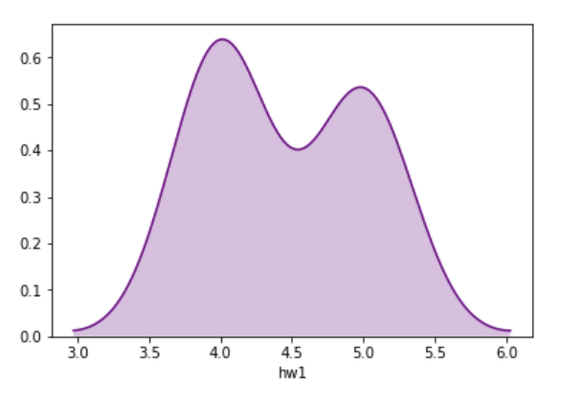
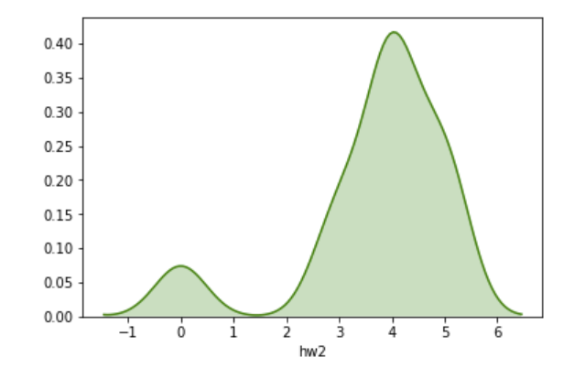
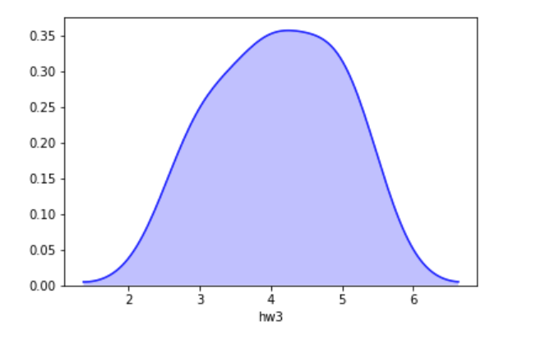
Python HW Review
Assignment | Mean Grade | Median Grade | Standard Deviation
1 | 4.5 | 4.0 | 0.5
2 | 3.7 | 4.0 | 1.3
3 | 4.1 | 4.0 | 0.8

Slide 5
My impressions
Progress!
The grades for the last assignment are (statistically) normal, great job!
You are all going to be great programmers if you want to be!
“To introduce and provide hands on training in current and relevant computational/bioinformatics resources, approaches, and programs applicable to a wide range of biological and biomedical research. A particular emphasis will be placed on genomic scale analysis of DNA and gene expression.” √

Slide 6
Recap
Last class:
Introduction to Bioconductor II
This class:
Computer Lab with Bioconductor focus
Next class:
Microbiome Analysis I (Robert/Dr. Arthur)

Slide 7
If you need a workflow or dataset, select 1, or 2 if ambitious
EnhancedVolcano (will need results from test of differences)
DESeq2 (airway dataset)
edgeR (airway dataset)
RNASeq123 (airway dataset)
Phyloseq (https://bioconductor.org/packages/release/bioc/vignettes/phyloseq/inst/doc/phyloseq-analysis.html_)
proteomics (PXD015383)
scRNASeq (https://osca.bioconductor.org/lun-416b-cell-line-smart-seq2.html)

Slide 8
All links from “If curious” slides
Principled Data Processing a talk given by a friend and hero of mine Dr. Patrick Ball
Resources from the Algorithmic Justice League founded by Joy Buolamwini
Git Best Practices from Seth Robertson
PCA in 3 Easy steps by Sebastian Raschka
EICC GitHub
16s microbiome pipeline
RNASeq (bulk) analysis pipeline

Slide 9
Coursera Recommendations free (and reputable!) knowledge
Reproducible Research from Johns Hopkins University
Introduction to Data Science in Python from University of Michigan
Python for Genomic Data Science from JHU
Statistics for Genomic Data Science from JHU
Bioconductor for Genomic Data Science from JHU
Genomic Data Science Specialization from JHU
Applied Data Science with Python Specialization from UM
Python for Everybody Specialization from UM
Statistics with Python Specialization from UM

Slide 10
All links from “References & Resources” slides
The Task is a Quantum of Workflow, Human Rights Data Analysis Group
The Structure and Interpretation of Computer Programs, Massachusetts Institute of Technology
Delphine R. Boulbes, Tracy Costello, Keith Baggerly, Fan Fan, Rui Wang, Rajat Bhattacharya, Xiangcang Ye, L. M. E. (2018). A Survey on Data Reproducibility and the Effect of Publication Process on the Ethical Reporting of Laboratory Research. Clincical Cancer Research, 18(0227). https://doi.org/10.1158/1078-0432
Baggerly, K. A. (2010). The Importance of Reproducibility in High Throughput Biology: Case Studies in Forensic Bioinformatics. https://d18ky98rnyall9.cloudfront.net/_26e6ce51223ccd2d11a3cec15a76ca6a_baggerly.pdf?Expires=1580169600&Signature=AkbbZbGv6lIn9DtOgsXjtcWV1tjbkbjVCCMQxUWioSIUITk83IEjFVtZzi8EQthF9U7xUEz-Mm3klrelJLb11UKDh5UA6CLQji38ubhrk4~fPT2rXPevWgL-6ld1fYNJ3h41woDGWrVa9
Patrick Ball, P. D. (2016). Principled Data Processing. Data & Society Research Institute. https://www.youtube.com/watch?v=ZSunU9GQdcI
Prasad Patil, Roger Peng, J. L. (2017). A Statistical Definition for reproducibility and replicability. BioRxiv. https://doi.org/https://doi.org/10.1101/066803
Sandve, G. K., Nekrutenko, A., Taylor, J., & Hovig, E. (2013). Ten Simple Rules for Reproducible Computational Research. In PLoS Computational Biology (Vol. 9, Issue 10). https://doi.org/10.1371/journal.pcbi.1003285
https://xkcd.com/927/
Watermark
Pandas (cheat sheet)
Numpy (cheat sheet)
Sinfo
Python for Beginners from Python
Reading List of Introductory Books from various authors from Python
Python Cookbook from O’Reilly
Peters, T. (2004). PEP 20 -- The Zen of Python | Python.org. Retrieved April 14, 2019, from https://www.python.org/dev/peps/pep-0020/
https://plot.ly/python/v3/ipython-notebooks/principal-component-analysis/
https://www.rna-seqblog.com/statquest-pca-clearly-explained/
https://www.kindsonthegenius.com/2019/01/12/principal-components-analysispca-in-python-step-by-step/
https://scikit-learn.org/stable/modules/generated/sklearn.decomposition.PCA.html
https://sebastianraschka.com/Articles/2015_pca_in_3_steps.html
https://www.kindsonthegenius.com/2019/01/12/principal-components-analysispca-in-python-step-by-step/
https://scikit-learn.org/stable/modules/generated/sklearn.decomposition.PCA.html
http://www.datasciencemadesimple.com/get-maximum-value-column-python-pandas/
https://pandas.pydata.org/pandas-docs/stable/index.html
https://bioconductor.org/about/
https://bioconductor.org/help/faq/
https://bioconductor.org/help/course-materials/
https://bioconductor.org/help/community/
https://bioconductor.org/help/support/

